Slide 1
Model View Controller
IN710 OOSD 2017
Session 11.1
Notes:
With design patterns, we saw standardised, efficient architecture for solving specific types of programming problems.
In these cases, the design pattern was a component of a larger architecture.
But there are also patterns that describe complete architectures.
The generic 3-tiered architecture is one that you are familiar with; the “manager class” is another.
We are now going to spend some time looking at a large and important architectural pattern – Model-View-Controller. MVC is a specific type of 3-tiered architecture that is very well suited to large distributed (i.e. cloud-based) enterprise systems.
Many modern IDEs support MVC – e.g. Ruby, and Yii for PHP. We are going to use .NETs MVC paradigm for web sites, because this will allow us to continue writing C# (along with HMTL and CSS) and it is the foundation of most modern ASP.NET web sites. (There is an older architecture called Web Forms, that is easier to build, but is slow on the browser, and doesn’t scale well.)
Since we are switching to a web execution environment, we’ll quickly review the process model, for those of you who aren’t currently taking Web3.
One note: We will be working with the version of MVC (MVC 5) that is one generation behind. The latest version (MVC 6) is part of the new version of the .NET framework (known as .NET Core).
At the moment, the OP machines don’t support .NET Core. I asked around and people in the business said that Core was still be treated as immature, and that most people were sticking with MVC 5 for now. So we will too.
The changes in Core are, for what we will be doing, primarily in system infrastructure and some cosmetic features of the interface. The fundamental elements of the architecture are unchanged, so it will be easy to migrate when the time comes.
Our focus is on learning the MVC design pattern, and that is the same in both versions.

Slide 2
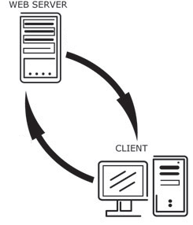
ASP.NET Process Model
Web server locates requested page and sends it to the ASP.NET engine for processing…
ASP.NET Web Site stored on the server
This processing often involves database access…
The output is HTML and often JavaScript
HTML stream (and possibly media files) sent across internet
Client machine running browser
requests MVC web page via special URL….
Browser processes HTML and displays web page
Often, this request includes user-
supplied data via GET or POST
Notes:
You may remember a slide much like this from web 2.
In that case, the web pages stored on the server contained both regular html and php stuff, marked up with the <php> tag
The general process with ASP is the same. However, the ASP applications on the server are MUCH, MUCH more complicated
And, consequently, the processing which happens on the server is MUCH, MUCH more complicated
We can do things pretty easily with ASP.NET that would be very difficult with php

Slide 3
ASP.NET Development Model
Build a .NET application
Written in a combination of C#, HTML and CSS
Full access to .NET libraries
Deploy your application on an ASP.NET server
All your C# code is translated into client-side code (HTML, CSS and JavaScript) and shipped back to the client’s browser.

Slide 4
Developing Locally
Visual Studio provides a localhost ASP.NET engine.
During development, this mimics the server.
Notes:
So we can do all our development locally
When you go to production, you publish your site to an IIS server.
BTW: A dual monitor setup is very nice for ASP work, if you have access to one, so that you can see both Visual Studio and the browser.

Slide 5
Model View Controller
History
Basics
Versions
Notes:
We’ll start by looking at this architecture. Note that this isn’t a “Microsoft” architecture, nor is it a new architecture. Many languages/development platforms support or require it.
First mooted in the 1970s for use with SmallTalk, a proto-OO language
Fell out of favour during the event-driven years, but is resurging now because it maps well to the independent server-client model of web programming.
MVC models promote “separation of concerns” into Model (data), View (UI), and Controller (application logic).
There are many versions of MVC. Most differ in precisely what the controller does.
The GoF MVC is different from the one ASP.NET MVC uses.
We’ll concentrate on that specific one, but if you care, it’s worth reading the GoF presentation and thinking about the differences between them.

Slide 6
ASP.NET Model View Controller
Model: In-memory C# or ORM to MSSQL database
Classes that describe system data and business rules.
Maintains the system’s persistent state.
View: HTML with extensions
The user interface.
Controllers: C#
Classes that
Handle application-specific logic
Accept user data from the View (like Form Action)
Send data to the View for display
Communicate with Model classes
Notes:
The three parts of an MVC architecture.
Model = C# classes or C# classes and an underlying database
View = souped-up HTML
Controller = Written in C# code, uses the Model classes, passes data to the View.
While the roles are distinct, there is of course communication between the layers.
For example,
The controller classes fetch data from the classes in the model that communicate with the database
The controller classes pass data (in the form of model class instances) to the Views to render and display.
The Views have knowledge of the model class structures
So when people talk about “separation of concerns” it doesn’t mean that they are completely separate. The theoretical advantage of MVC (in general and this version in particular) is that the responsibilities are clearly assigned.

Slide 7
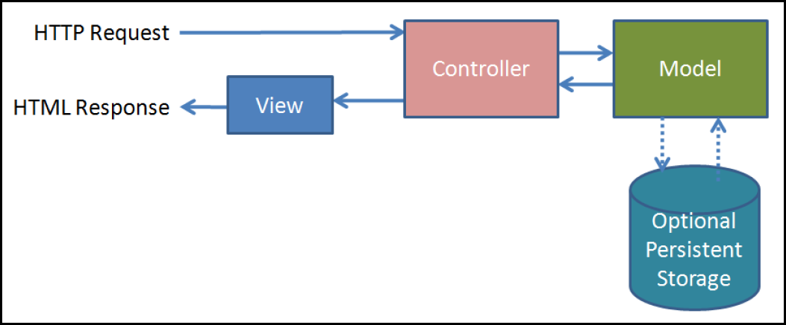
ASP.NET Model View Controller
Notes:
HTML requests under this model go to a Controller class method, not to a page. So the URLs are very weird.
The server software translates (routes) from controller method name to page name.
You will see this difference in your own browsers.
The controller talks to the persistent storage, requests data, modifies data, etc.
The controller then passes information to the view.
The view is translated by the engine into something browsers can understand, and that is shipped off to the client.

Slide 8
ASP.NET Development Philosophy
Separation of concerns
Automate development where possible
Convention over Configuration
File Structure
Naming
Developer control over HTML
Full strength of .NET classes and language features.
Notes:
Separation of concerns: as discussed
Automate development where possible: Powerful ORM. Similarly, much of the HTML writing can be replaced by more succinct shorthands.
Convention over Configuration: MVC5 figures out what you want based on where files are placed and what things are named. This has both advantages and disadvantages, and we will consider it in more detail as we go along.
File Structure
Naming
Developer control over HTML: Early server-side HTML generators where all the code was written in the OO language, produced very bloated HTML. In MVC5, you can choose to write your own HTML, exactly as you want it shipped to the browser. This give developers better control.
Full strength of .NET classes and language features (e.g. lambda expressions).

Slide 9
ASP.NET Mechanics
URLs serve methods, not files.
Lifecycle
The URL tells the Routing mechanism which Controller class to instantiate and which of its methods to call.
The method determines which View is required and prepares and passes data to that View.
The View is rendered, and passed to the client browser.
Notes:
URLs serve method calls, not files. This will become clearer when we see some examples in a moment.
Models know nothing about Views. Your model classes should never try to respond to user input or control user output.
Controllers know about Views and Models, but should never try to do their jobs (data storage and UI, respectively).
So when you have functionality to add or a problem to fix, you should be easily able to tell what part of the code you should be working on.

Slide 10
ASP.NET Model View Controller
ASP.NET MVC Engine
Is passed to
Gets Model data
Model
Sends (special) URL
Browser
Controller
Processes and prepares data and passes it to selected View
View
View produces HTML
for the browser
Notes:
More detailed
2: Controllers are classes. Their methods are accessed via URL. That is, when the browser presents a particular URL (we’ll see the syntax in a minute), it maps to a method call on an instance of a Controller class. Keep this in mind: In ASP.NET MVC, URL’s aren’t pages, they are method calls.
3: The Model is also implemented as a set of C# classes. The system has an automatic ORM that will build a database for you based on your classes (NB: This works really well in simple situations, not so well in complex ones, or some that give it fits, like one-to-one relationships.) We will see how this is done next week.
3: If you aren’t using a database, the controllers can build and initialise instances of the model classes to serve as the data.
4: This processing step can be anything you want. Controller classes are C# and work exactly like all .NET classes
5: View files are a combination of HTML and C#. The C# is demarcated (much like php). The engine “executes” the C# part and combines the HTML that needs to be generated with the hand-written stuff and returns it all to the browser.

Slide 11
Razor
Processes C# embedded in the View HTML
Notes:
This is the extension to HTML.
When working in ASP.NET, you can stick certain bits of C# into the HTML. Most usefully, for-loops and complex data objects. Saves lots of typing.
We will see this as we go.

Slide 12
ASP.NET MVC Elements
Models
Normal .NET C# classes that hold your data
Can contain business logic methods
Often map to an underlying relational database
Notes:
You can do the models without a remote database (that’s how we will start), or with.
If you are using a remote database, you can use ADO, or Entity Framework, classes first or database first.

Slide 13
ASP.NET MVC Elements
Controllers
Normal .NET classes descended from System.Web.Mvc.Controller.
In simplest case: one controller ⬄ one web page
Always named: <name of web page>Controller
Each Controller class contains a number of “action methods”
Every action method has one or more associated Views
Default View identified by naming convention (View name = Method name)
Other Views can be invoked explicitly
Data passed to View as arguments or via “ViewBag”
Action methods called via URL. The system returns the HTML stream rendered by the View invoked by the Action method code.
Notes:
We’ll see lots of examples, but here is the big picture…
For example, HomeController, AboutController, ManagerController, InventoryController, AccountController, etc.
An action method is one that causes a View to render, usually by returning a ViewResult or ActionResult object
There is always a default view associated by name. So if you have a controller method called ShowResults(), the system expects a View called ShowResults for the method to communicate with. This is part of “Convention over Configuration”.
ViewBag is an untyped associative array.
Usually what is passed by argument is a prepared instance of one of the model classes.
Each View can be bound to a single model class type. It then “knows” that type and can use its data properties and methods during rendering.
Anything else you want to pass has to be dumped in the ViewBag.

Slide 14
ASP.NET MVC Elements
Views
HTML pages
May contain Razor blocks
Notes:
Razor blocks are essentially C# code.
The system translates their output into HTML for you.

Slide 15
Building an ASP.NET MVC Application
Creation
Adding a Controller
Adding a View
Passing Data from Controller to View
Adding a Model Class
Working with Strongly Typed Views
Incorporating a Form
Basic Input Validation
Notes:
The actual workflow is sort of “everything at once”.
The model first, of course, and planned output screens, but application logic development tends to be “make a controller method, build its View” and repeat. Back and forth between controllers and views.
To start though, you have to put something first, and we will look at the various steps in this order.

Slide 16
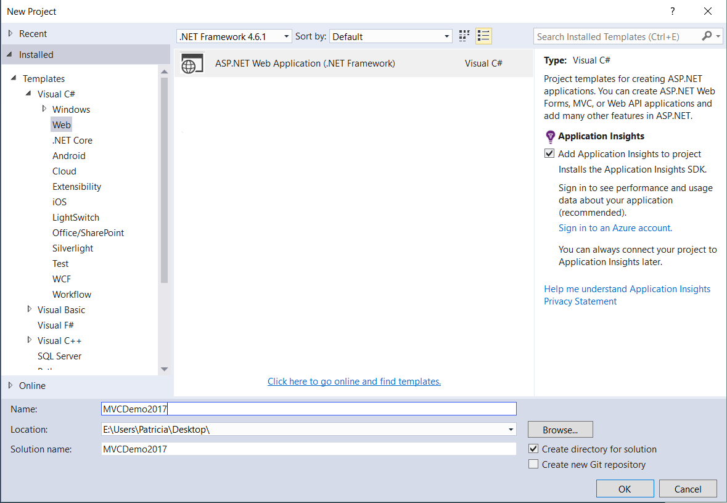
Creation
File->New->Project
Web
ASP.NET Web Application
Notes:
Don’t choose New->Web Site, even though we are building web sites. That is a different paradigm.
Choose New->Project

Slide 17
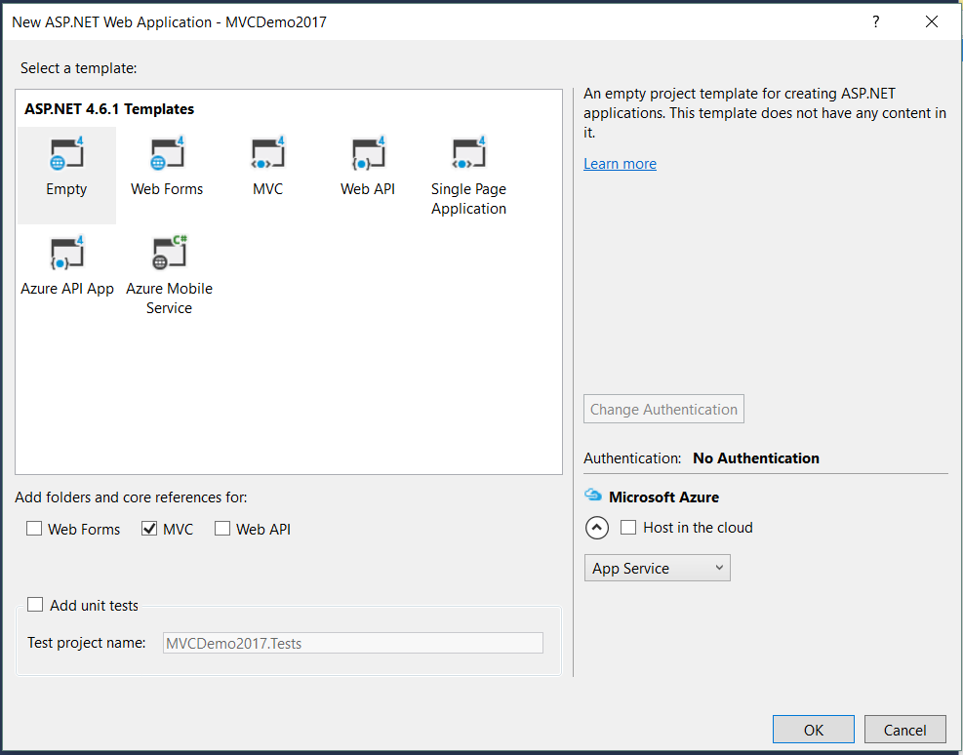
Creation
Empty
MVC
Notes:
If you hit the MVC icon directly, you get a VAST amount of template code, which you then have to customise.
You might want to start out with that some day, but it won’t make any sense at first.
If you don’t see this, then MVC is not correctly installed on the machine.
Go to NuGet and install it.
We want to be using MVC 5 under 4.6.1

Slide 18
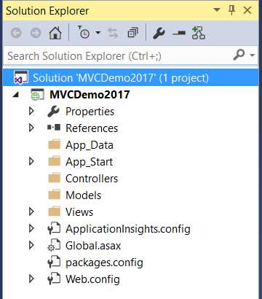
Creation
Notes:
Here’s what you get:
Properties: Ignore for now
References: Full of useful packages for development. For example, the ORM (called Entity Framework) lives in here
App_Data and App_Start: ignore for now
Controllers and Models: Empty. This is where you controller classes and data model classes will go
Views: Later, each controller (that you create) will get a folder here to hold its Views (as you create them)
Remaining utility files: Ignore for now
If you create all your elements via the menus (we will see in a moment) everything will go into the folders where the system expects it to be and have the names the system expects it to have (Convention over Configuration).
You can of course do all creation manually, but then you need to be sure you don’t violate the system’s expectations.
To start, we will let the system create things for us.

Slide 19
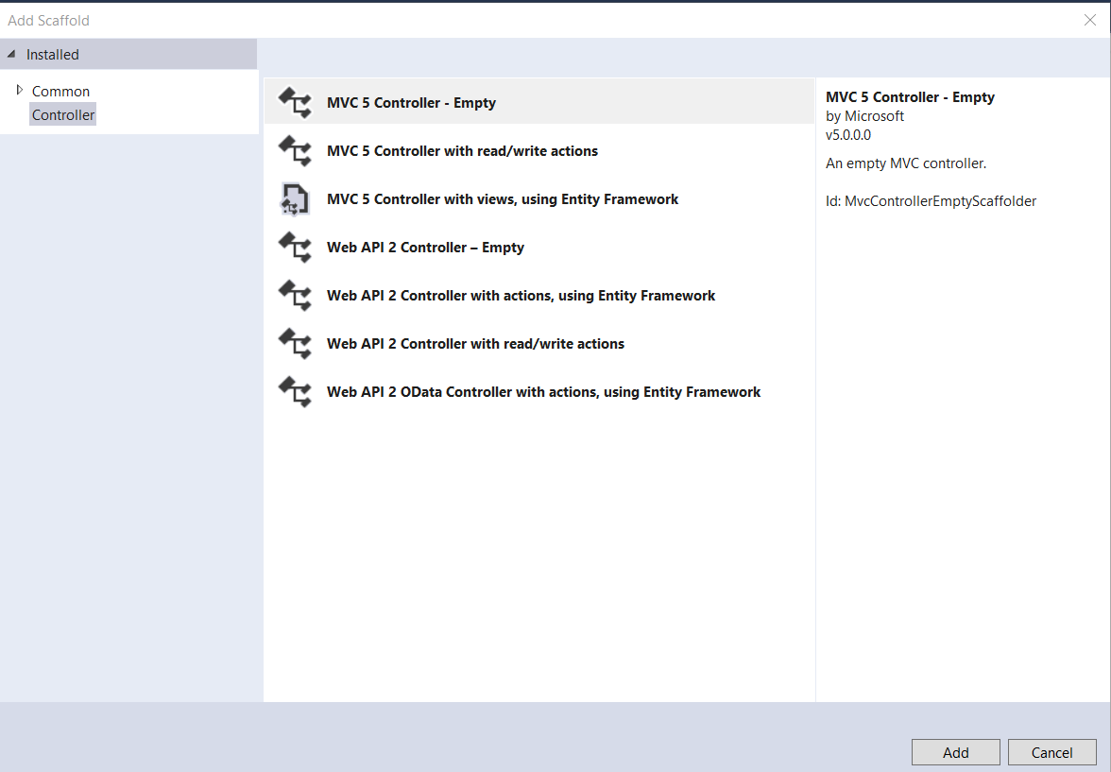
Making a Controller
Right-click on the Controllers Folder
Select Add->Controller
Notes:
Again, the templates are for after you know what you’re doing.
When starting out, select MVC 5 Controller – Empty
Click Add

Slide 20
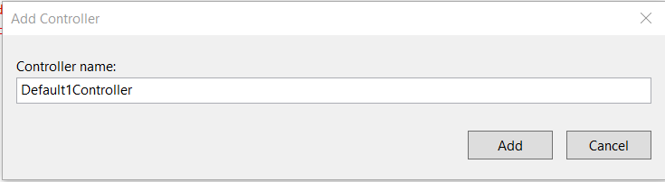
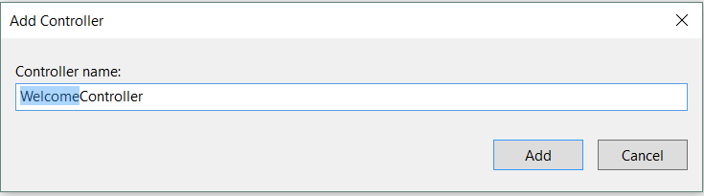
Making a Controller
Notes:
You will see this.
Controllers are always named <somethingDescriptive>Controller.
Here, you are being offered the name DefaultController.
Remember that for simple sites, controller ⬄ page. So generally, we want the Controller name to be something about the page. HomeController, ContentController, SearchController, whatever.
For this first example, we are making a welcome page, so we will call out controller WelcomeController
Click Add

Slide 21
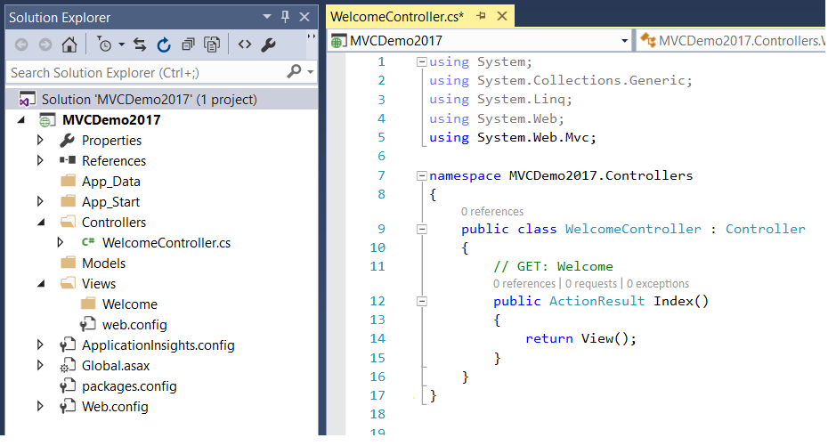
Making a Controller
Notes:
Your new Controller is simply a C# class, descended from the system class Controller.
See where the .cs file is placed. This is a requirement. Controller class files must be in the Controllers folder.
You get the namespaces you need.
You get the class declaration for class WelcomeController:Controller
You get one action method called Index. This method does nothing and returns the default view (remember what the default view is? => One with the same name as the method, in this case, Index). That’s what “return View()” with no arguments means.
Note that it is actually possible to run this application now.
If you hit the green triangle, the system will open a browser and make a call to the local mock ASP engine with the URL localhost:xxxx.
This won’t make any sense to the engine, so you’ll just see this:

Slide 22
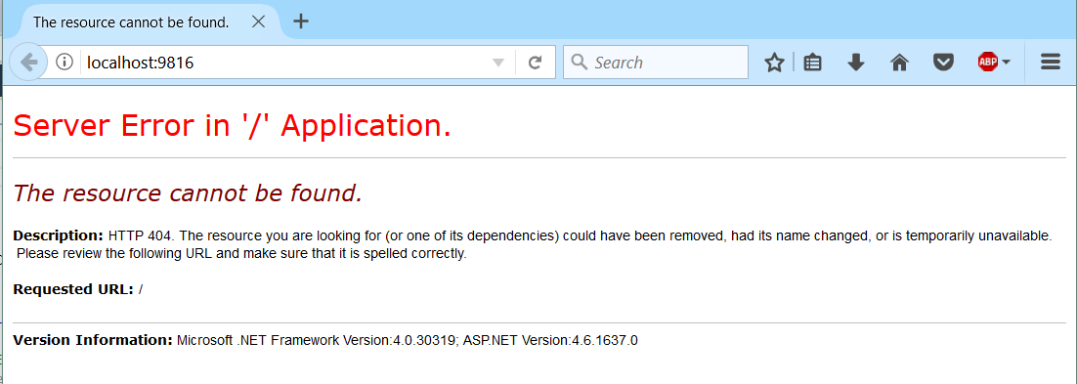
Making a Controller
Notes:
You have to use special URLs when developing in MVC.
These URLs are really method calls. They name the controller you want and the method you want to call.
For example, with the code as written and the application running as shown, we can enter into the browser’s address window localhost/Welcome/Index (our controller’s name – omit the Controller part of WelcomeController – and the name of a method it contains).
This will call the Index method.
(Note that, of course, we do this programatically IRL).
Let’s see what happens when we do that...

Slide 23
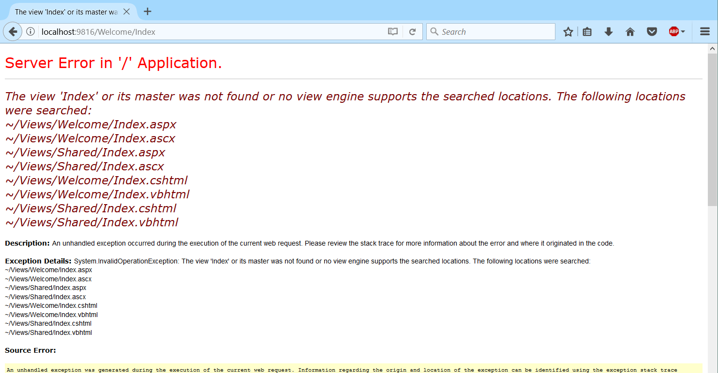
Making a Controller
Notes:
It still doesn’t work, but it’s definitely trying to do something...
See the URL? This says “Get the Controller called Welcome and call its Index() method” (How do you think I would call some other method of the Welcome Controller? localhost/Welcome/otherMethodName)
Look carefully at the output.
The system, when it called Welcome.Index() went looking for a particular file and couldn’t find it. It is looking for some kind of web page called Index. It will take various forms: .aspx, .ascx. cshtml, vbhtml, etc. And it will look in various places, you can see the folders it searches.
This is the system hunting for the View. Because of Convention over Configuration, it expects to find a View called Index that goes with this method called Index. It expects it to have one of those file types and be in one of those folders.
Because we haven’t made the View yet, it spits.
So let’s make the View…

Slide 24
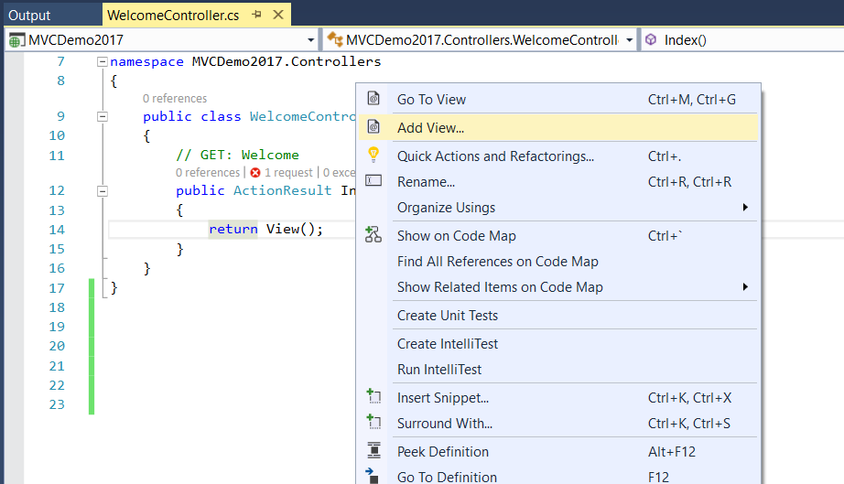
Making a View
Right-click anywhere inside the method for which you are creating a View.
Select Add View

Slide 25
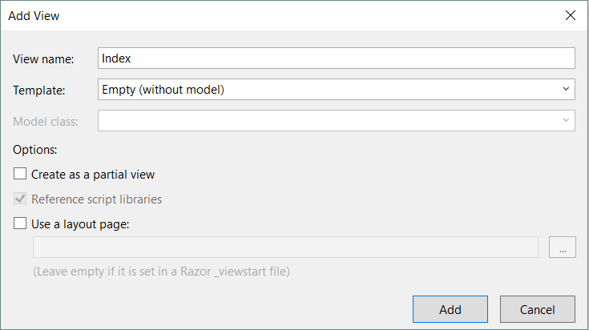
Making a View
Notes:
The default View matches the name of its Action Method
You can make as many views as you want and you can call any view you want from inside an action method by explicitly naming it. But if you just say “return View()” as we have done in our controller, it looks for the View with the same name as the method.
If you make a strongly typed View (with Model), your View will be able to work with one of you model classes (i.e. you’ll get code completion for properties and methods). You’ll be prompted to select one of your model classes. We will look at this technique in a bit.
Again, there’s lots of Boilerplate you can get.
We ignore Partial Views for now
Using a layout will default to that ViewStart.cshtml. Very similar to Master Pages in Web Forms. We’ll look at this in a while. For now, turn it off.

Slide 26
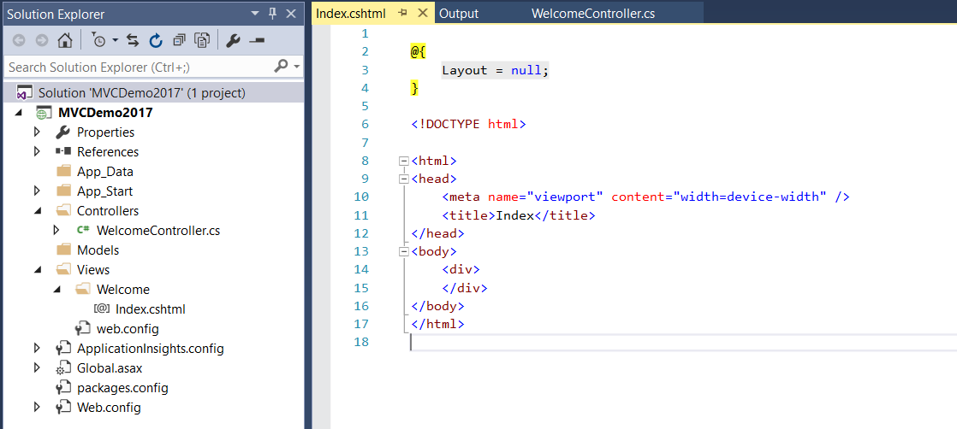
Making a View
Notes:
And here it is. The system has created heaps of stuff for you.
In your Views folder, you now have a folder for the Controller, called Welcome. Any Views you create for Action methods of class WelcomeController will be placed here
In Views/Welcome, you have your first View file, Index.cshtml
You can see the editor window with index.cshtml on the right.
A Razor block that basically says you’re not using a layout. Lots of other stuff can eventually go there.
Then a vanilla HTML skeleton. Remember that the Model and Controllers are written in C#, but the Views are written in HTML (with CSS)
Let’s add some more HTML.

Slide 27
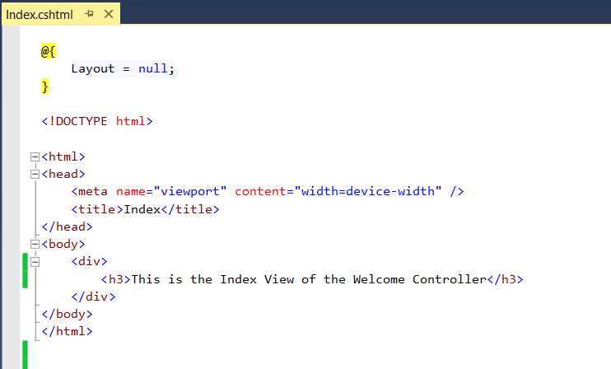
Making a View
Notes:
So here’s some added HTML…
Remember when we accessed localHost/Welcome/Index before and it crashed?
What do you think will happen now?
It will access localHost/Welcome/Index which is really a call to Welcome.Index()
Which runs the code in Welcome.Index() executing the return View() command which transfers control to the View called Index in the Welcome folderr, which is then rendered as HTML (in this case, just dealing with that Layout bit...) and sent to the client

Slide 28
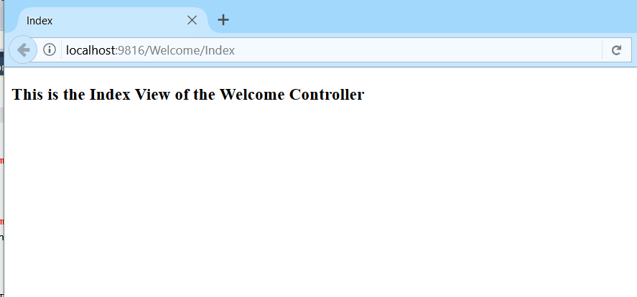
Making a View
Notes:
There is the URL as promised…
And the View rendered.
If you get errors here about missing an assembly, you need to update your MVC references. Just uninstall and reinstall with Nuget.

Slide 29
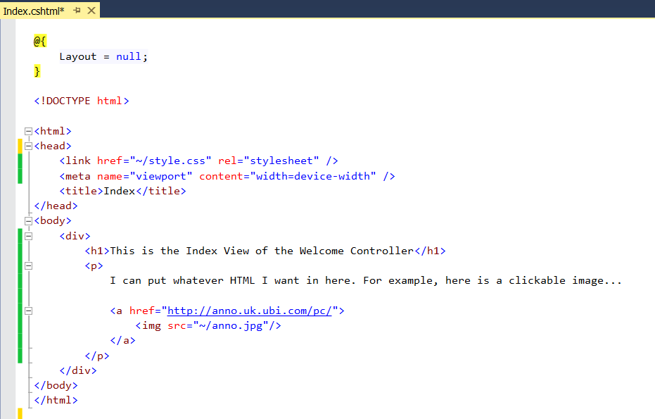
Making a View
Notes:
Let’s look at some more complex View code…
I’ve just dropped a jpg into the root (with Add Existing Item). The ~/ is shorthand for “the root folder”.
I’ve also added a style sheet to put some padding around the image. This works exactly the same as any web page. When working in the View, you can do all the normal HTML and CSS things.

Slide 30
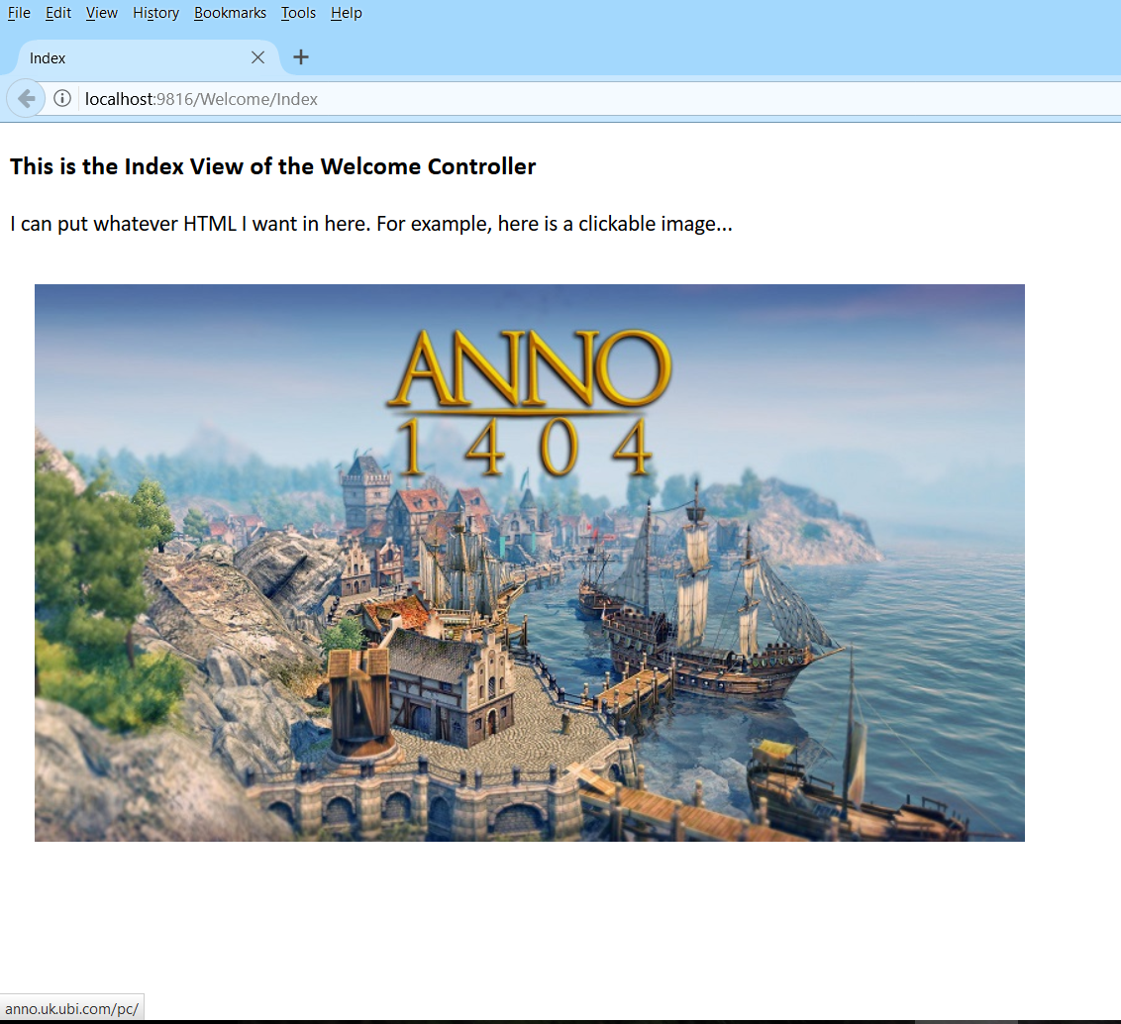
Making a View
Notes:
Here is the browser.
Note the URL.
Hovering over the image (cursor not visible in screen capture) shows the link href at the bottom of the screen.
So in the first instance, your Views can have all the HTML & CSS you know. In addition, we will see that they can have Razor blocks (basically chunks of C# which are parsed and rendered into HTML by the ASP engine).
We will also see that you can pass data, including complex objects, from the Controller to the View. You can use these objects to generate your HTML dynamically.

Slide 31
Building an Application
Passing data from Controller to View
return View() inside an Action method is a constructor call to create an instance of the default View (the View with the same name as the method).
return View(“Bob”) is a constructor call to create an instance of the View named Bob.
return View(modelData) creates the default View and passes in some data.
return View(“Bob”, modelData) creates View Bob and passes in some data.
Notes:
Note the difference between the quoted and unquoted argument (yuk)

Slide 32
Building an Application
Data passing options:
“Strongly type” the View to a Model class and pass an instance of the bound type
Use ViewBag
Notes:
Passing model data: When you create the View you can pick one (and only one) of the model classes to bind it to.
On invocation, you can pass it an instance of that model class (can also be an enumerable collection of the bound class)
Anything else you must pass in with the Viewbag
You can do both – i.e. strong type and Viewbag
We will look at ViewBag first…

Slide 33
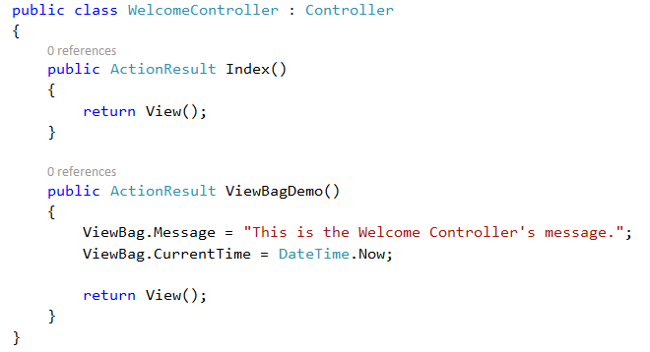
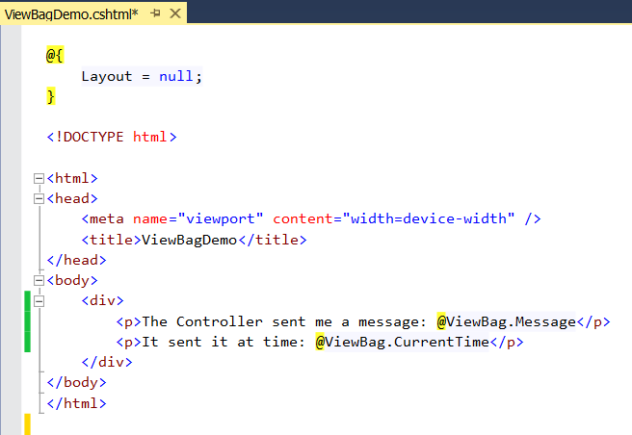
Example -- ViewBag
Notes:
Assume I have added an Action method and View as shown. These controllers are just C# classes and you can do all the usual things with them, like writing methods.
Note that the method has a return type of ActionResult, which means that it needs to exit with a return View(xxx) call.
Note that the ViewBag is loosely-typed. You don’t have to predeclare its contents, you don’t have to specify the type of the things it holds, and you don’t have to have all the same type in it. It is a big amorphous data bag.
You have zero compiler protection here – be careful.
The View you add by right-click->Add View
Note the use of Razor. HTML has no idea what ViewBag is, or that it is being passed data, or any of that.
That part of the logic needs to be parsed and executed by the engine and translated into normal HTML.
We indicate this is happening with the Razor prefix @ (logically equivalent to turning on PHP).
Questions:
What file contains that View code? Views/Welcome/ViewBagDemo.cshtml
What URL should I give to browser to call the ViewBagDemo() method? localhost/Welcome/ViewBagDemo
What will the browser show me? (see next slide)

Slide 34
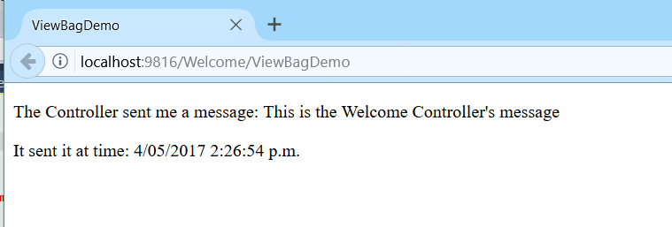
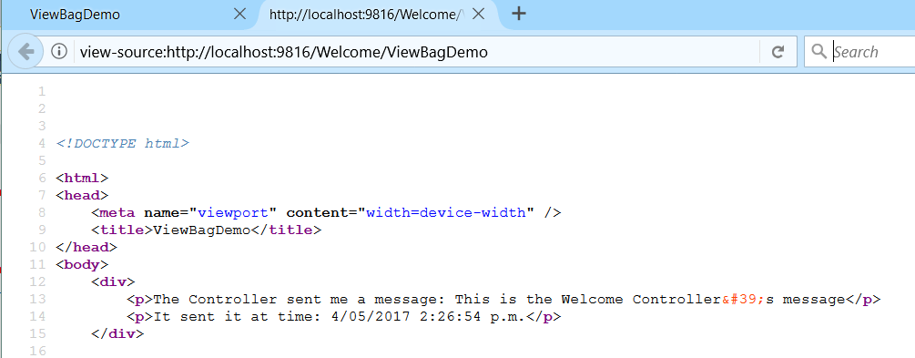
Example -- ViewBag
Notes:
Note the URL.
If we view source here, we see that all the Razor stuff, the ViewBag stuff is gone.
The engine deals with it and renders it into HTML which is returned to the client

Slide 35
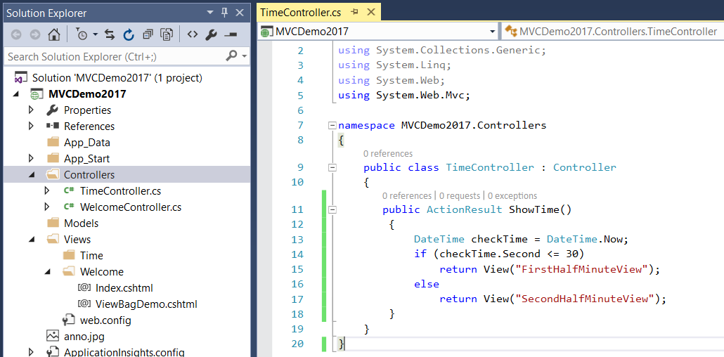
Multiple Views
Notes:
A given action method can return a choice of Views other than the default View that shares its name.
In this situation, I have made two Views for the new TimeController – EarlyView and LateView
Both were made by right clicking in the body of the controller code
Here are the views…

Slide 36
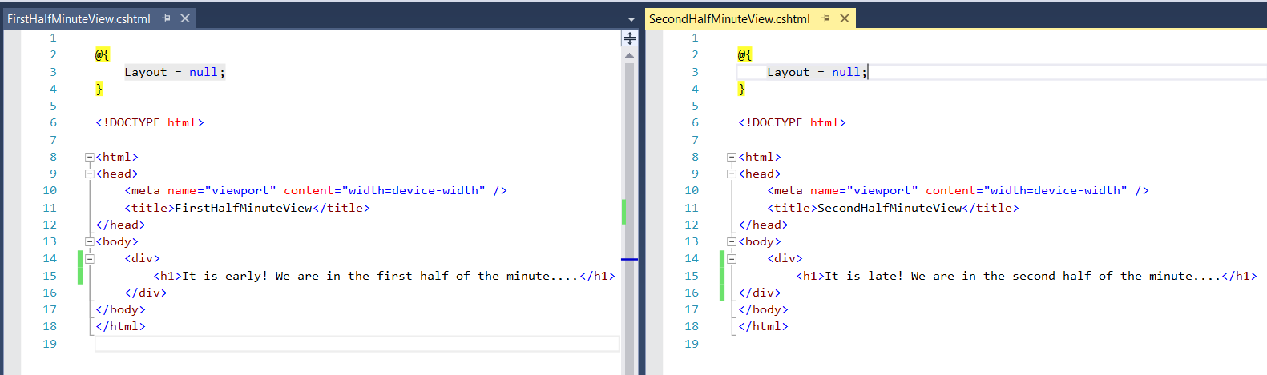
Multiple Views
What is the URL we provide to run this application?
What does the application do?
Notes:
Localhost:xxxx/Time/ShowTime. Remember that the URL is a method call. It does not say which HTML file to render. That happens from within the controller code via the returning of a View.
Shows the early string when it opens in the first 30 second of the current minute and the late string in the second 30 seconds. If you refresh for awhile, you will see it change.

Slide 37
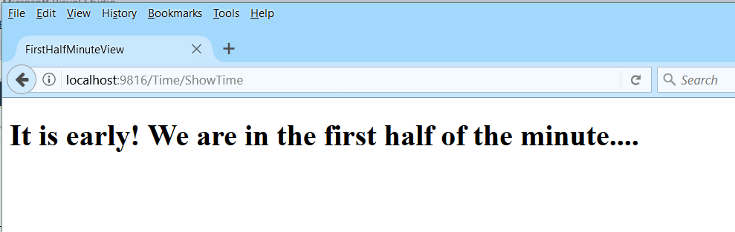
Multiple Views
Notes:
You can’t tell from the URL what View is created

Slide 38
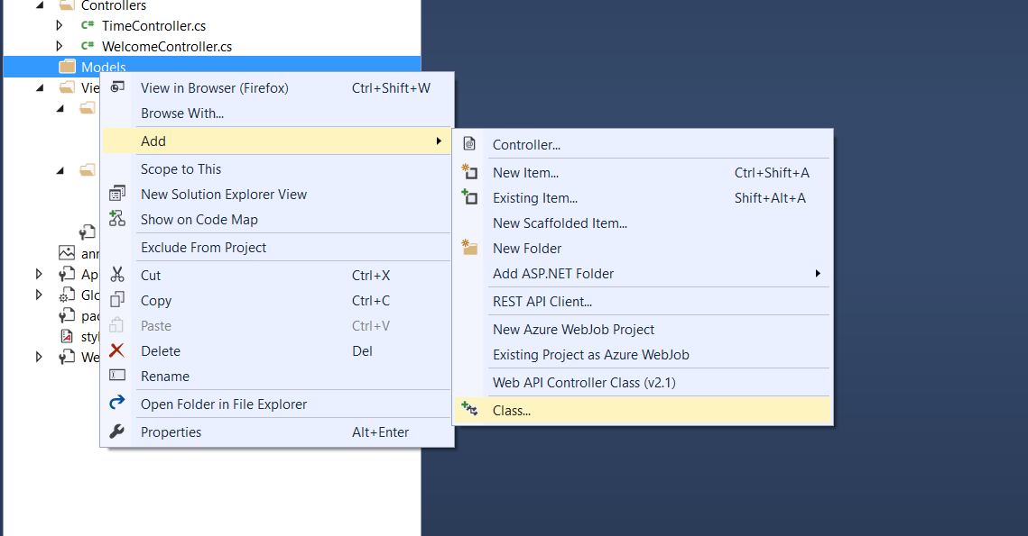
Creating a Model Class
Notes:
You should be starting to see a pattern here….
Right-click on the Models folder, then ->Add->Class
The system puts all the files where they should go (Convention over Configuration…)

Slide 39
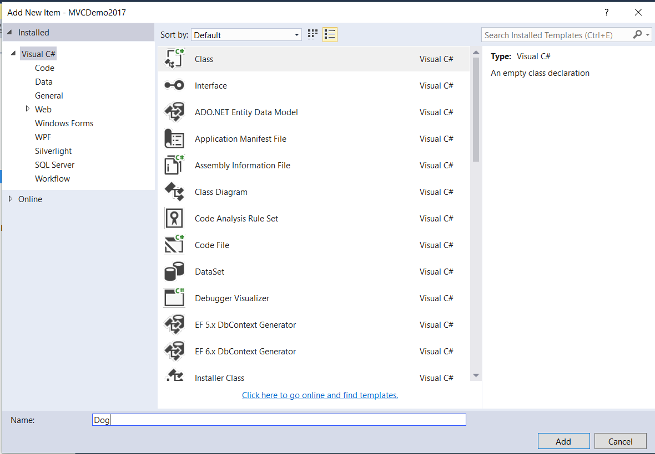
Creating a Model Class
Notes:
Let’s create a class called Dog.
The model classes are our data model and the have a lot in common with an entity-relationship model (except that, since they are classes, they can have methods).
This simple Dog class is going to look a lot like a simple Dog table.

Slide 40
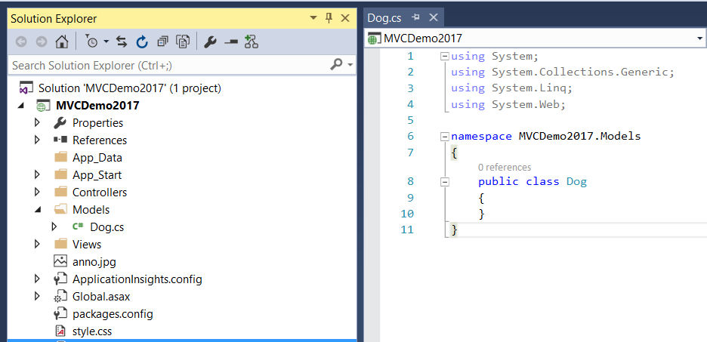
Creating a Model Class
Notes:
And this is just an ordinary class.
Note the namespace. Your models will sit in their own namespace, like this. Did you notice the namespace for the controllers?
In an enterprise situation, we will be using an underlying SQL database. Entity Framework can go either classes first or database first, as before.
For certain kinds of data models, if you want to go classes-first, you have to distort your classes just a little to get ORM to work (e.g. one-to-one relationships are awkward), but in most cases, you write your code and classes in the most natural way, and ignore most of the relational stuff.

Slide 41
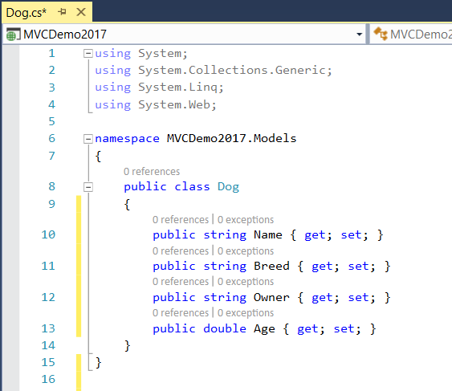
Creating a Model Class
Notes:
Just for example purposes we make this little dumb class.
IRL, we would probably be looking at a very different architecture. Ideas? (Breed and Owner as classes/entities in the db)
But right now we just want to look at how to pass model objects
Now that we have a model class, we can create a “strongly typed View” bound to this model class.
This view will be able to accept instance of Dog as input. It will know about the fields of Dog.

Slide 42
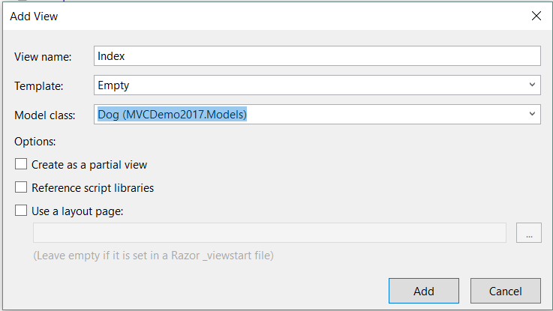
Create a Strongly Typed View
Notes:
Let’s make ourselves a new controller called “DogShow”, and let’s build a View for its default Index method.
This will be a strongly-typed view, bound to class Dog.
You know how to get to the “Add View” step, so we’ll jump right to that….
Select “Empty” as the template rather than Empty (without model)
Select the class you want from the drop down. It will show all your available classes.
NB: after adding a model class, if your class doesn’t appear in this drop-down, just build your project.

Slide 43
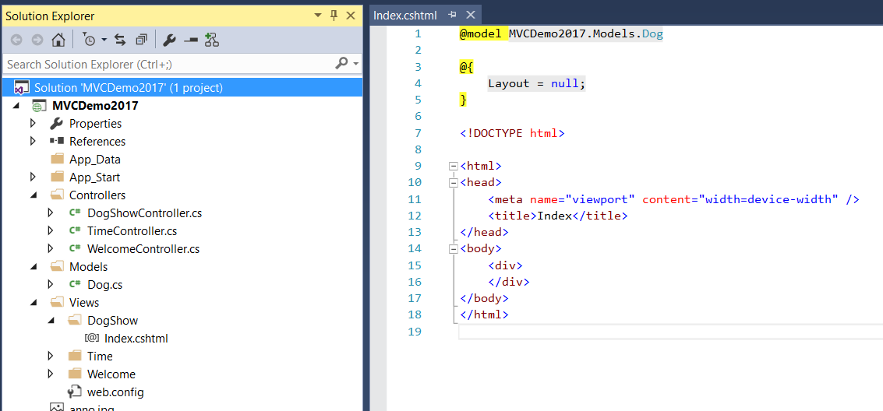
Create a Strongly Typed View
Notes:
We can see our newly created view in its proper place in the file structure
That “@model” Razor statement defines the binding.
Read “This View’s model is <namespace>Dog”
Note the lower case ‘m’ in @model. That defines the bound model class. As we will see in a moment, the actual model instance will be called ‘Model’ with an uppercase M. Can be confusing; make sure you are careful with it.

Slide 44
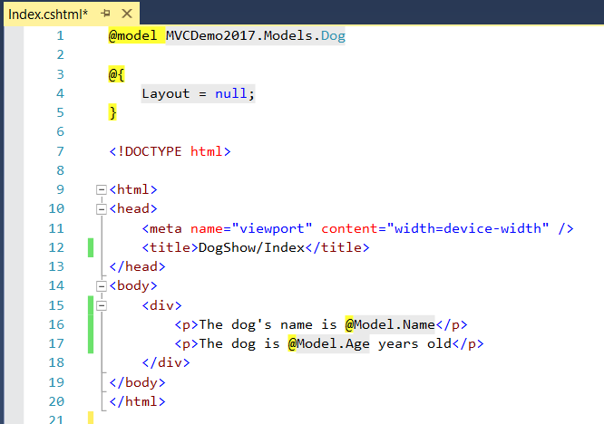
Create a Strongly Typed View
Notes:
A strongly-typed View expects to be passed an instance of its bound model class by its Controller. (We will see how to accomplish this in a moment.)
In the cshtml, this object will be named Model (with a capital M). It is a Razor object, not an HTML object, so you preface it with @
(Again, note the different capitalisation: @m to bind; @M to access)
Model is expected to be an instance of Dog, and you get code completion (couldn’t get it in the screenshot ☹)
Now let’s look at how the Controller passes the Model instance in to its View…

Slide 45
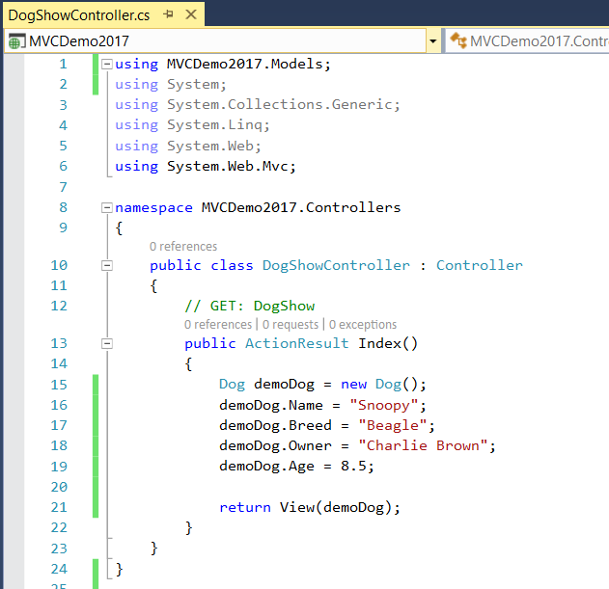
Passing to a Strongly Typed View
Notes:
…It simply creates an instance in the normal OO way, and passes it as the argument to the return View call
Remember that a string argument (i.e. one in quotes) is the name of the View to be rendered, but a concrete argument (i.e. the name of a variable/object instance) is an object to be passed to the default View. Confusing? => Yes.
But here’s how it’s done:
NB: The Models and the Controllers are in different namespaces. You will need to add the using statement for the namespace to be able to see your Model classes, just as you always have to do. The easiest way is to type out Dog once (you’ll get the red underline). Right-click on it and select Resolve from the pop-up menu.
Note that you can pass other stuff as well, just put it in ViewBag.
To pass a model object to a strongly typed alternative view: return View(“AltViewName”, objectName);
We will see later how to build special classes called ViewModels that allow us to pass more than one class instance to a View.

Slide 46
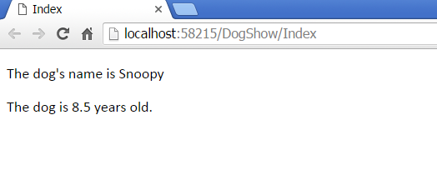
Passing to a Strongly Typed View
Notes:
As always, note the URL

Slide 47
Passing Data to a Controller
Next time…
Notes:
We’ve seen how to get data from the model to the controller and from the controller to the view.
How can we pass data from the user to the Controller?
There are actually two ways, corresponding to GET and POST, as you would expect (i.e. via URL query string or via controls in an HTML form. We will start with that next time.

Slide 48
Practical
Build an ASP.NET MVC application that tells the user how long it is (in days) to either Queen’s Birthday, Halloween or Boxing Day.
Randomly select which holiday the user sees at each visit to the web site.
To allow for scalability, create an appropriate model class to hold the name and date and associated image file name for a holiday instance.
NB: It is very important that you keep the application logic and the UI completely separate. Do not try to perform randomisation or calculations in the View.

Slide 49
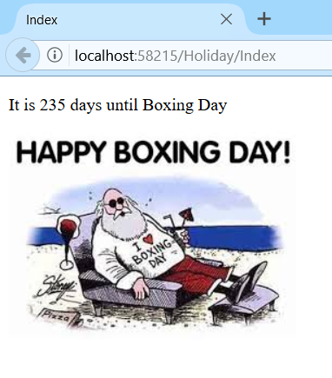
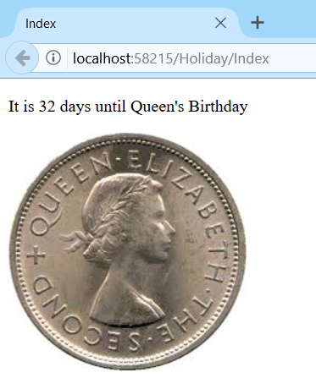
Practical
Notes:
Here is my solution when it chooses boxing day and when it chooses Queen’s birthday. You also want Halloween
Note that the URL is the same.

